Slide 1
Examining the Hydrologic Properties of the Missouri River Basin
Rachel Bash, Keqi He, Caroline Watson, Haoyu Zhang
Notes:
Rachel

Slide 2
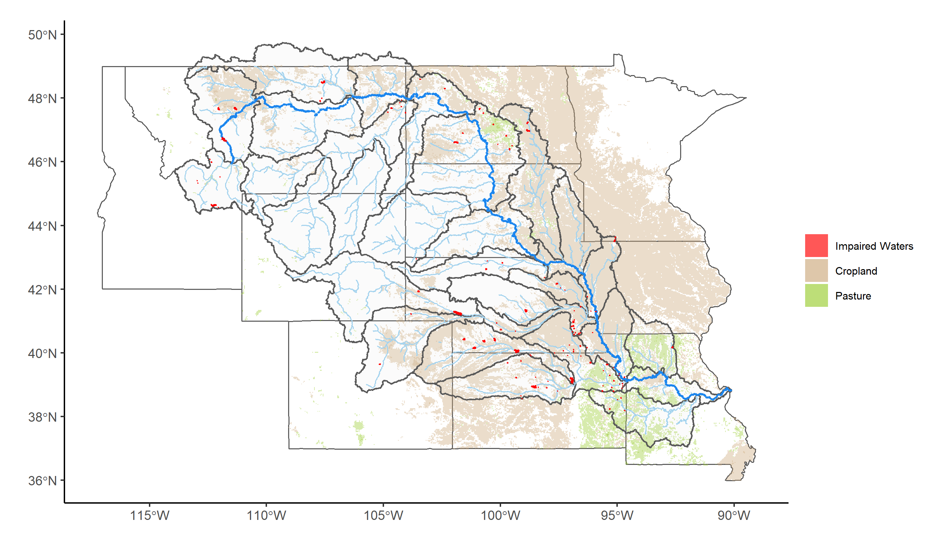
Study Rationale
Largest river in N.A.; 2nd largest watershed.
Large proportion of agricultural lands.
Nutrient enrichment & water impairment
Map Layers Sources:
Land use: GAP/LANDFIRE National Terrestrial Ecosystems 2011;
Impaired waters: EPA ATTAINS (cf. Clean Water Act 303d List 2015)
Watersheds & streams: USGS
Notes:
Hubert ~ 1min
As you may have known, the Missouri River is the largest river in North America, and it also has the second largest watershed of 338 million acres including a small part in Canada.
The basin is primarily rural, but also has several large or medium-sized cities. As shown on this map, a large proportion of the region is agricultural land. 218 million acres out of 328 million acres in US (64.2%) are related to agriculture, and two major land uses are cropland and pasture.
Across the whole basin, agricultural lands are the predominant source for nutrient loading into water bodies. According to Clean Water Act 303 d list 2015, more than 160 waterbodies are impaired due to nutrient enrichment.
Since most of agricultural lands are located in the lower Missouri basin, in this project we focused on sub-basins in the southeast.

Slide 3
Our Research Questions
How have changes in discharge (i.e. water quantity) interacted with nutrient enrichment (i.e. water quality) in the Missouri River Basin?
a) Nutrient levels have increased over time
b) Discharge has become more variable over time
c) Nutrient levels increase with discharge
What effects do specific flood and drought events have on the water quality and quantity of rivers in the Missouri River Basin areas of interest?
a) Rivers will exhibit a flushing behavior due to the land use and type of flow during storms
b) Discharge will decrease during drought due to decreased overland flow.
What factors contribute to the variability of total nitrogen in the rivers?
a) Land use, year, discharge, phosphorus, and HUC region will contribute to the variability of total nitrogen across sites
Given past and current data, what can we predict about the future state of water in the Missouri River Basin?
a) Total flow in the Missouri River Basin is increasing (non-stationary) over time
b) The future situation of the river basin will see the continuation of current trends of increasing overall volume of flow.
Notes:
caroline

Slide 4
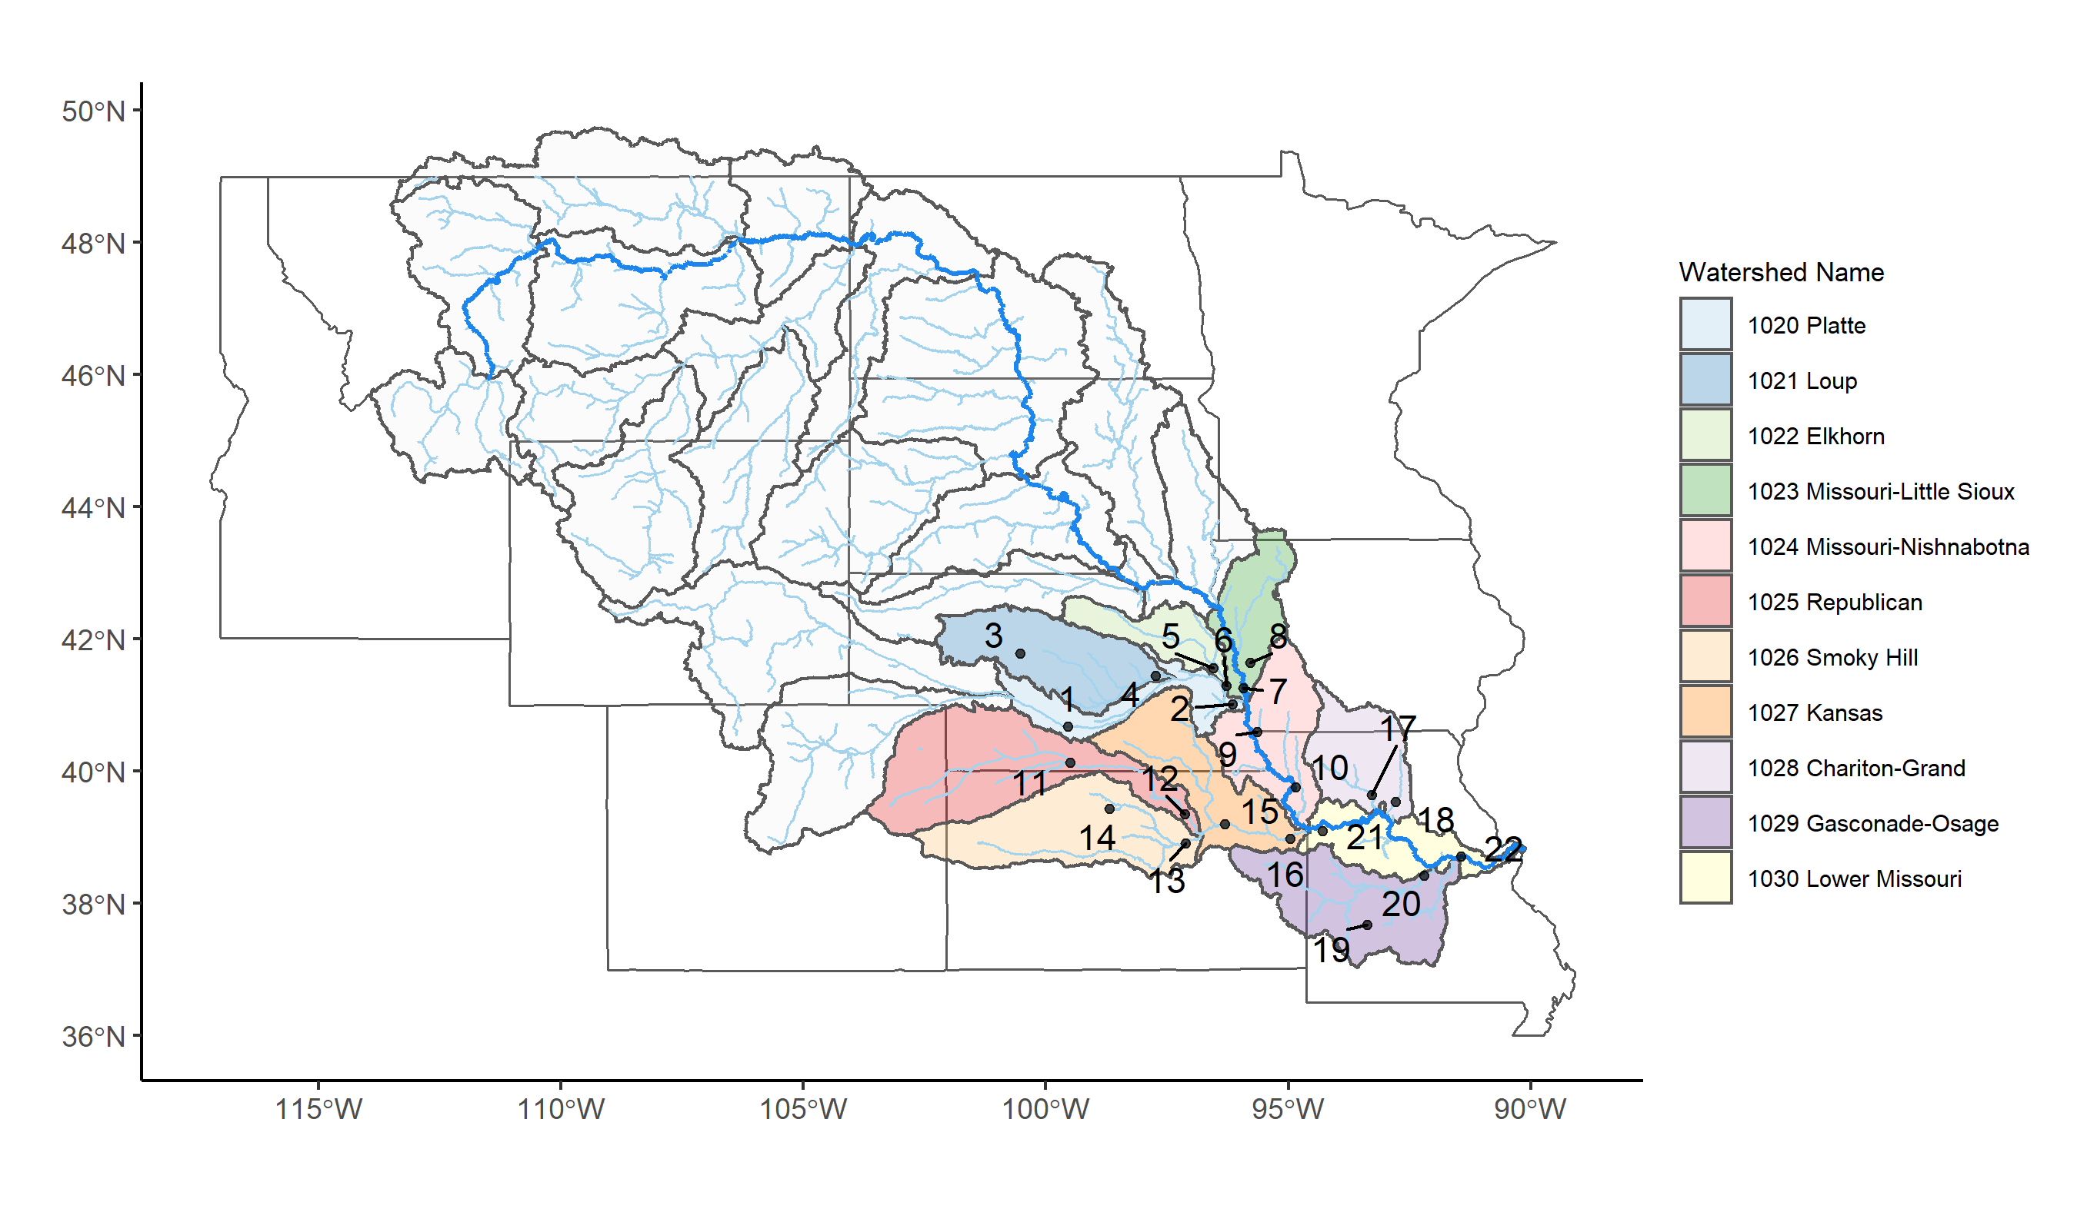
Our Approach
22 sites chosen throughout HUCs 1020 – 1030
Nitrogen, Phosphorus, Discharge, Population, Time
Steps:
Filter sites in HUC 1020 - 1030 to only show us sites that contained discharge, nitrogen, and phosphorus data.
Choose 2 sites from each HUC sub basin for a total of 22
By comparing the periods of records for each chosen variables and finding the sites with the longest periods of records.
Notes:
Caroline

Slide 5
Dataset Information
Source: The United States Geological Survey (USGS) database
Notes:
Rachel
NWIS – read through column names
Together, these sites give us this metadata about our discharge, nitrogen, and phosphorus data
Notice that count is much lower for N and P, unfortunately

Slide 6
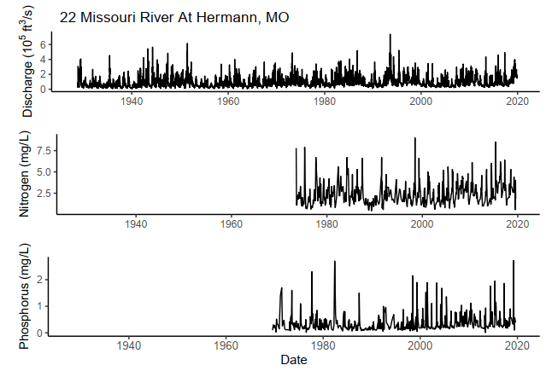
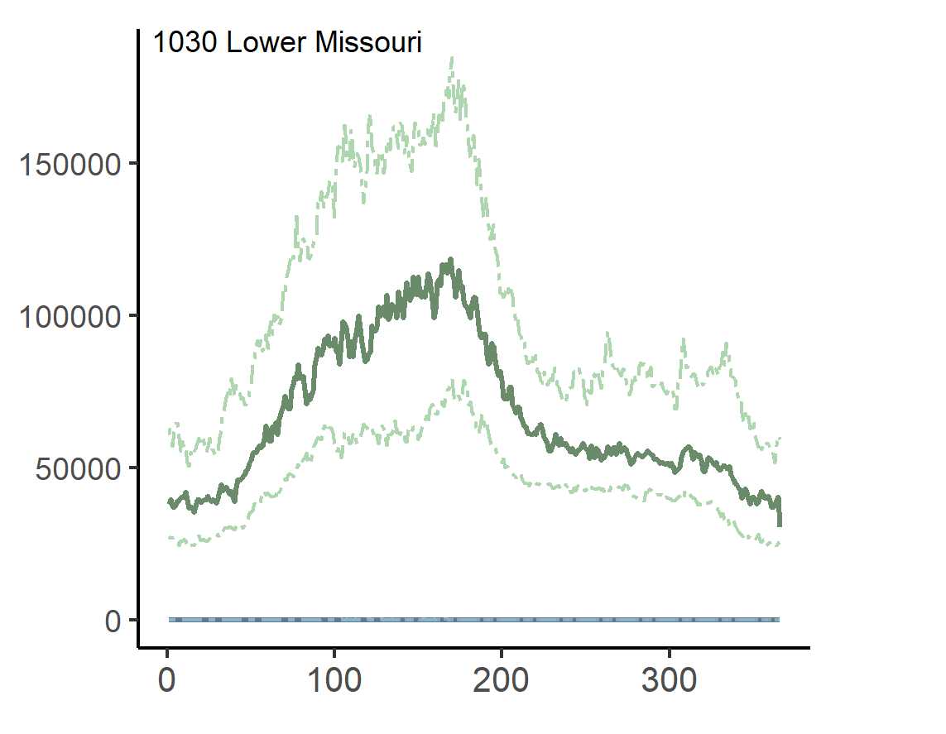
Exploratory Analysis
22
21
Day of year
Notes:
Keqi
Discharge, nitrogen, and phosphorus were plotted for each site and examined together in order to see if there were any obvious patterns or trends. Here shows an example from the most downstream site – No. 22 Missouri River at Hermann, MO. As you can see, this site has quite good data records, with continuous discharge data from “1928-10-01” to present, nitrogen data from “July, 1973” to “August, 2019”, phosphorus data from “July, 1969” to “August, 2019”.
We did the yearly discharge patterns analysis for each HUC4 watershed. Here shows typical discharge pattern within a year for HUC 1030 watershed. It is the most downstream sub basin. Site No. 22 is on the main stem of the Missouri River. As we can see from this figure, discharge reaches its peak during the summer and falls to minima during the winter, and it exhibits rather high variations across years, as indicated by the large difference between the medians and the first or the third quartiles. Furthermore, highest variations in discharge appear to occur in the summer, whereas discharge in the winter varies less among years. The large variability within a year and the seasonal pattern is only obvious in larger streams and rivers (No. 22) but not in small creeks (No. 21).

Slide 7
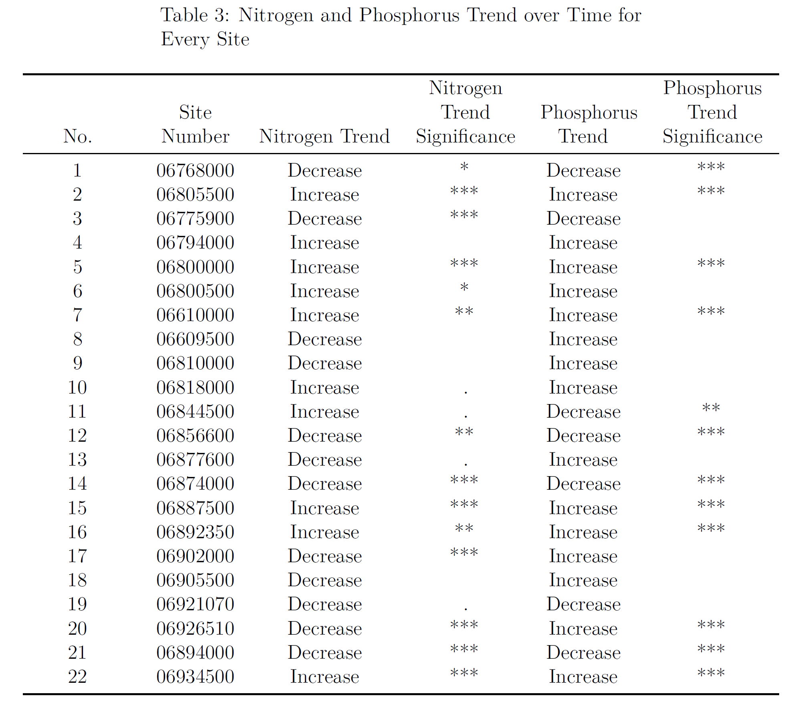
Q1: How have changes in discharge (i.e. water quantity) interacted with nutrient enrichment (i.e. water quality) in the Missouri River Basin?
Seasonal Mann-Kendall Trend Test
N: 7 increase; 7 decrease
P: 7 increase; 5 decrease
Mainstem increasing
Discharge × nutrient
18/22 positive relationship
Notes:
Hubert ~2min
To investigate the trend of nutrient concentration, we used long-term daily values and seasonal Mann-Kendal test. Among all 22 sites, 7 sites show significantly increasing trends in nitrogen concentration, while 7 show decreasing trends. For phosphorus, concentrations at 7 sites have increased over time, while decreased at other 5 sites. Despite inconsistent results at all sites, those on the mainstem show higher nutrient concentration, such as 7, 10, and 22.
We further examined the interaction between discharge and nutrient concentration. High-freq data were used for sites where the data are available, and for all other sites daily values were used. The relationship was analyzed by linear model with total nitrogen as the response variable and discharge as the explanatory variable.18 out of the 22 sites show a significant positive relationships.

Slide 8
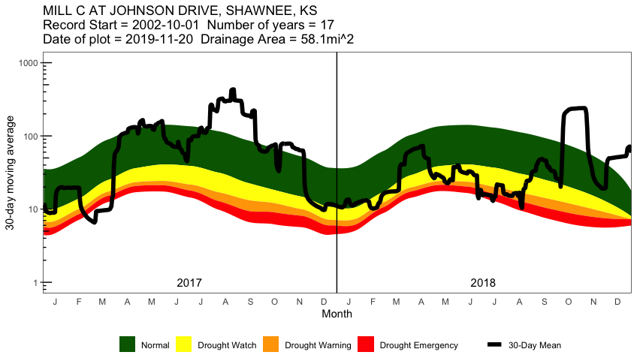
Q2: What effects do specific flood and drought events have on the water quality and quantity of rivers in the Missouri River Basin areas of interest?
Notes:
Caroline
This figure shows the 30-day moving average discharge (cfs) in 2017 and 2018 at Mill Creek at Johnson Drive, Shawnee, KS. The colors represent what normal conditions would be (green), drought watch conditions (yellow), drought warning conditions (orange), and drought emergency (red). These colors are calculated using historical data by determining the 0– 75th percentile of 30-day moving average flow in the river basin. The code for this graph was found through the USGS website and a 30-day moving average was kept, as opposed to going to a 7-day moving average, for this analysis since that is what USGS had published.

Slide 9
Q3: What factors contribute to the variability of total nitrogen in the rivers?
$Nitrogen=0.28+1.01\left(year\right)+0.99\left(population\right)$ $+1.44(phosphorus)$
Fixed effects: year and population
Random effect: HUC 4 area
Discharge was not significant
R² = 56.7%
With every decade, total nitrogen increases by 1%
With every 1000 person increase in population, nitrogen decreases by 1%
A unit increase in phosphorus increases nitrogen by 44%
Notes:
Rachel ~2 min
We wanted to see if across all site data, would nitrogen variability be affected by our variables time, phosphorus, year, population, and discharge. We used a mixed effects model, where year and population, time, and discharge were treated as fixed effects, and HUC 4 area was treated as a random effect, so that we take that variance into account when modeling the IV on total nitrogen.
Nitrogen was transformed in order to fit the assumptions of the mixed effect model that the DV has to be normally distributed. So, each coefficient was exponentiated in order to interpret the regression equation. I also divided Year by 10 and population by 1000 so that the massive range can be scaled down.
The intercept is 0.28, which is the mean of total nitrogen when year is 0 and population is 0 and phosphorus is 0. When exponentiating the Year coefficient, we can conclude that every decade has a 1.01 multiplicative effect on nitrogen. When exponentiating the population coefficient, we can conclude that every 1000 people have a 0.99 multiplicative effect on nitrogen.

Slide 10
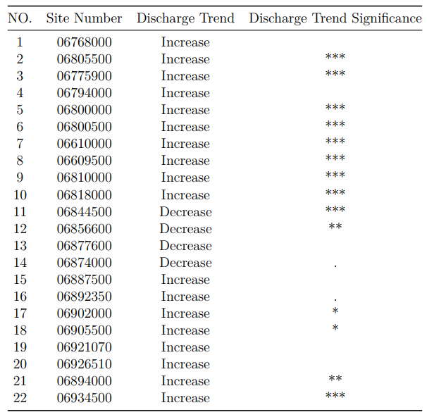

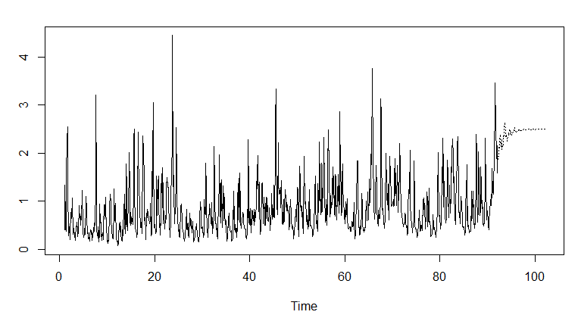
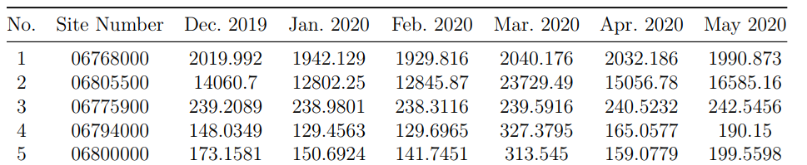
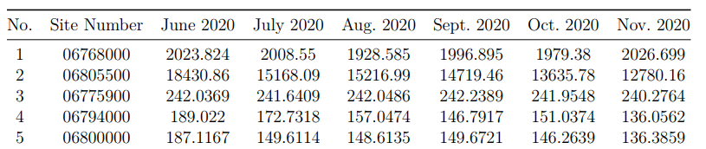
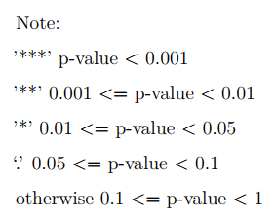
Q4: Given past and current data, what can we predict about the future state of water in the Missouri River Basin?
Mann-Kendall Trend Test
Autoregressive and Moving Average Models (ARMA)
AR part: involves regressing the variable on its own lagged (i.e., past) values
MA part: involves modeling the error term as a linear combination of error terms occurring contemporaneously and at various times in the past
Notes:
Keqi

Slide 11
Conclusions
There are few consistent trends across all of our sites
It depends on location of sites and size of river
Hard to compare the Missouri River to its smaller tributaries
Mainstem of the Missouri River has increasing Nitrogen, Phosphorus, and Discharge over time
Tributaries have different characteristics
Nitrogen is increasing in the basin over time
As population increases, total nitrogen loading into the rivers decrease (because of decreased agricultural land)
Notes:
Caroline
Keqi
Hubert
Rachel

